Slide 1
Exploration of superglobals in smarty

Slide 2
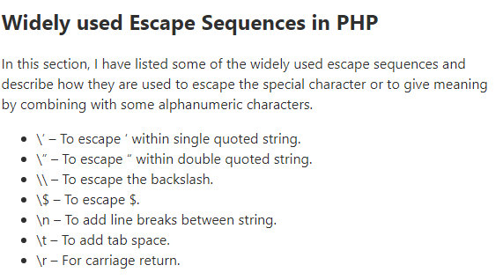
What is Escape?
Escape is a variable modifier that is used to encode or escape a variable to for example html, url, single quotes, hex, hexentity, javascript, and mail. By default, the escape is used by html.
We can escape all template variable output by wrapping it in htmlspecialchars( {$output}, ENT_QUOTES, SMARTY_RESOURCE_CHAR_SET);, which is the same as {$variable|escape: “html”}
Notes:
Links to refer to:
- https://stackoverflow.com/questions/48531908/escape-html-value-meaning

Slide 3
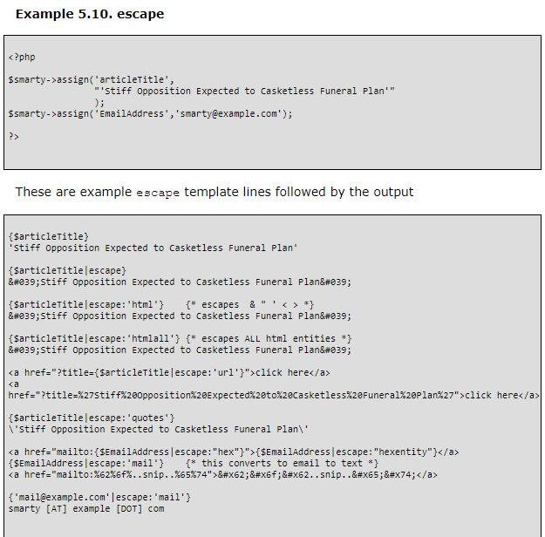
&amp; becomes & (ampersand)
&quot; becomes " (double quote)
&#039; becomes ' (single quote)
&lt; becomes < (less than)
&gt; becomes > (greater than)

Slide 4
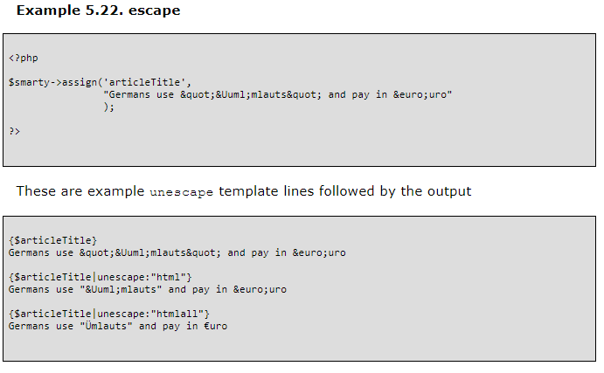
What is unescaped?
Unescape is used to decode entity, html, and htmlall. It counters the effects of the escape modifier for the given types. By default, it uses html:

Slide 5
What is sandboxing?
When PHP is mixed with templates, there are no restrictions on what type of logic can be injected into a template.
Smarty insulates the templates from PHP, creating a controlled separation of presentation from business logic.
Smarty also has security features that can further enforce granular restrictions on templates.
It is a security measure that is used to test unverified programs that may contain a virus or other malicious code, without allowing the software to harm the host device.

Slide 6
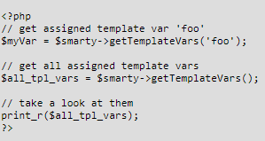
{assign} vs. assign()
{Assign} is a built-in function
Assign() is a class method
Used for assigning template variables during the execution of a template.
Used to assign variables/objects to the templates that were done by the front-end
We can use getTemplateVars() to configure what type of assigned variable values are returned from an assign() call
If no parameter is given, an array of all assigned variables are returned.
i.e. array getTemplateVars(string varname);

Slide 7
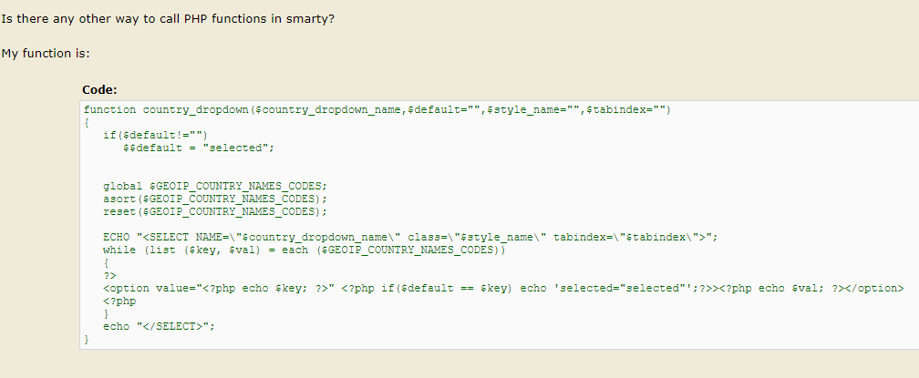
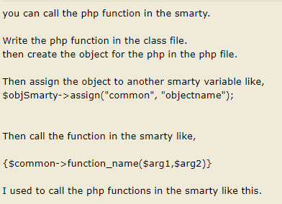
Can you call functions in class methods?
https://stackoverflow.com/questions/33097552/calling-static-methods-in-smarty-using-variable-as-class-name -> This post showed how Smarty allows functions to be used for a static class method.
Notes:
Links to refer:
- https://stackoverflow.com/questions/12054557/how-to-check-valid-object-of-class-in-smarty

Slide 8
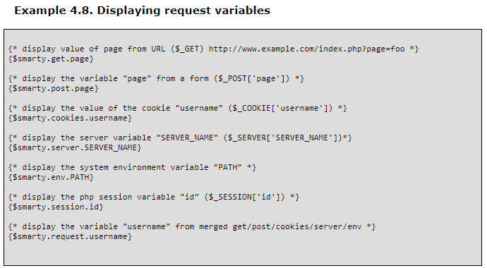
$smarty.const
Although Smarty provides direct access to PHP constants for convenience, it is typically avoided as this is mixing underlying application code structure into the templates.
A good practice is to assign specific needed values to template vars.
Smarty suggests that we must provide a specific data type that a class method like assign must operate upon. In that case, there are possibilities that the class methods can access functions and classes from the same and/or different files in a PHP application

Slide 9
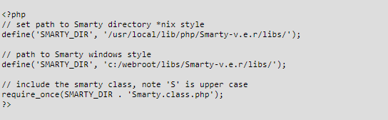
Smarty_dir operation
This is the full system path to the location of the Smarty class files. If this is not defined in your script, then Smarty will attempt to determine the appropriate value automatically. If defined, the path must end with a trailing slash/.
Basically, Smarty will assign a specific location to store all your programs that include key data in the virtual machine that we work with:

Slide 10
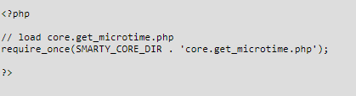
Smarty_CORE_dir operation
Like SMARTY_DIR, the purpose of the SMARTY_CORE_DIR is:
This is the full system path to the location of the Smarty core files. If not defined, Smarty will default this constant to the internals/ sub-directory below SMARTY_DIR. If defined, the path must end with a slash/. Use this constant when manually including any of the core.* files.

